Slide 1

A Statistical Model of Landslide Susceptibility in Northwest Colorado
Justin Cai
SML312 11/12/2022

Slide 2
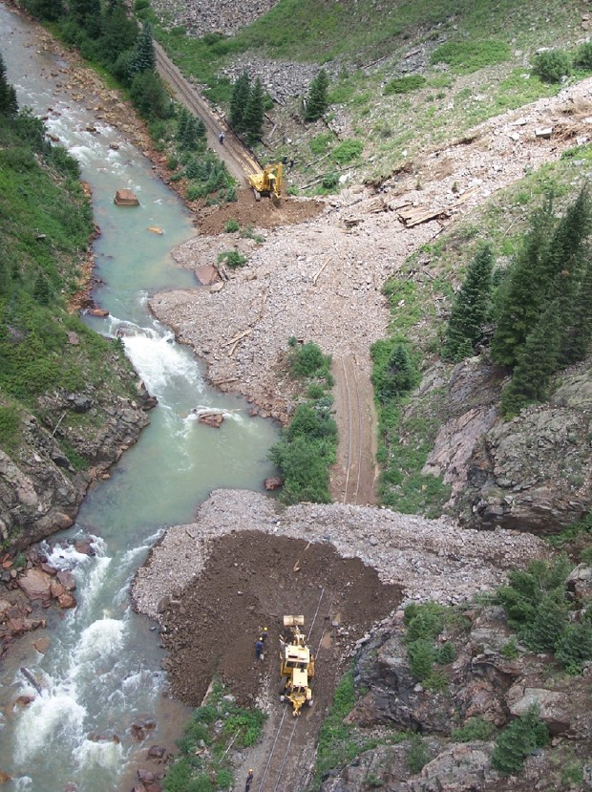
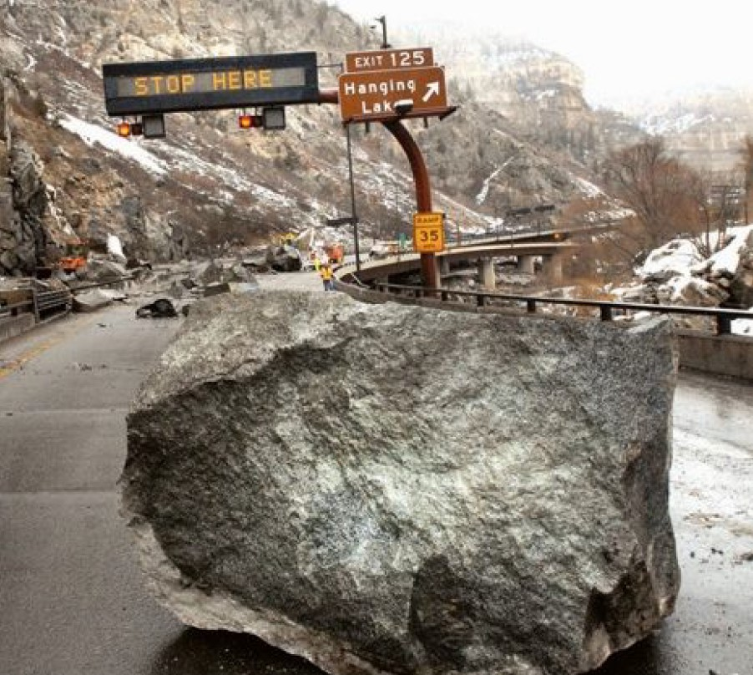
Background
Landslides in Colorado
9 deaths and over $9 million in damage in 2010
Rapidly growing population and tourism industry
Substantial risk to both people and infrastructure
No statewide map of landslide susceptibility (yet)

Slide 3
Question
Is it possible to construct a model that accurately predicts and maps landslide susceptibility across northwestern Colorado?

Slide 4
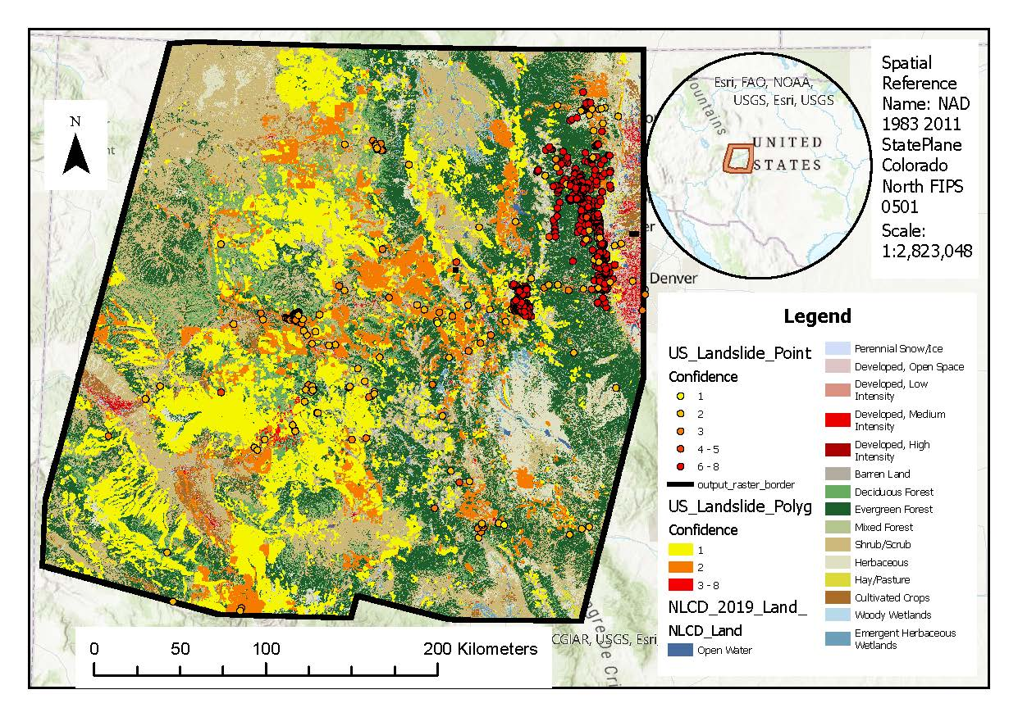
Study Area

Slide 5
Landslide controlling factors
Geomorphological
Elevation, slope angle, slope aspect, plan curvature, profile curvature, distance to faults, rock lithology, soil type
Environmental
NDVI, distance to rivers
Anthropogenic
Distance to roads, land cover

Slide 6
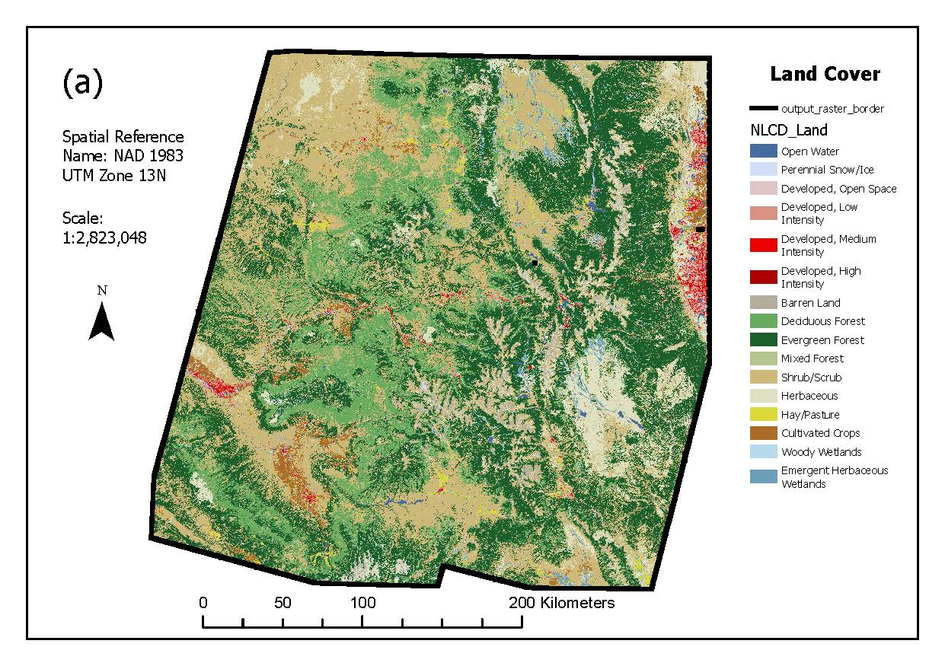
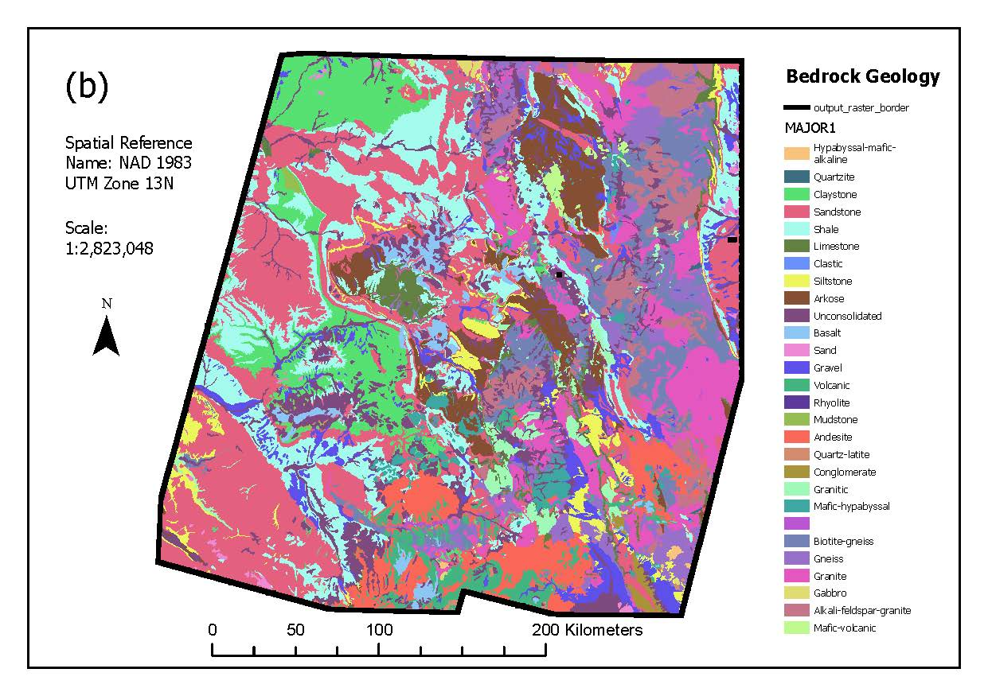
Land Cover and Bedrock Geology

Slide 7
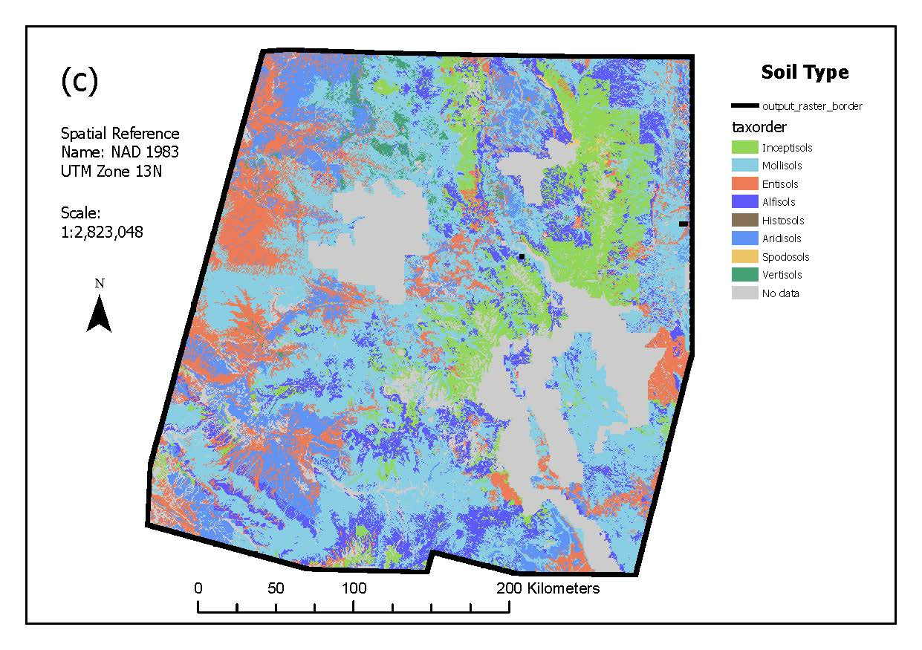
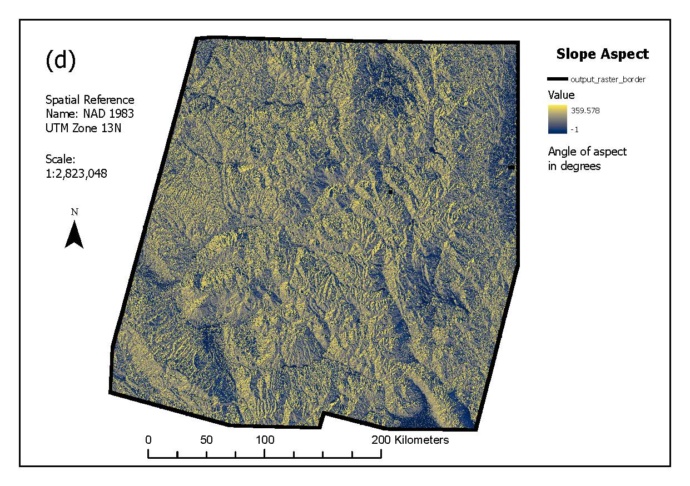
Soil Type and Slope Aspect

Slide 8
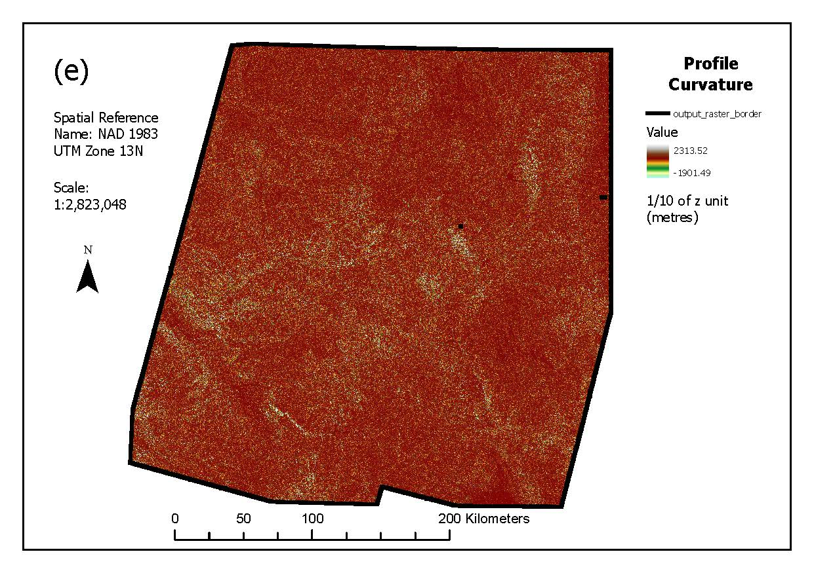
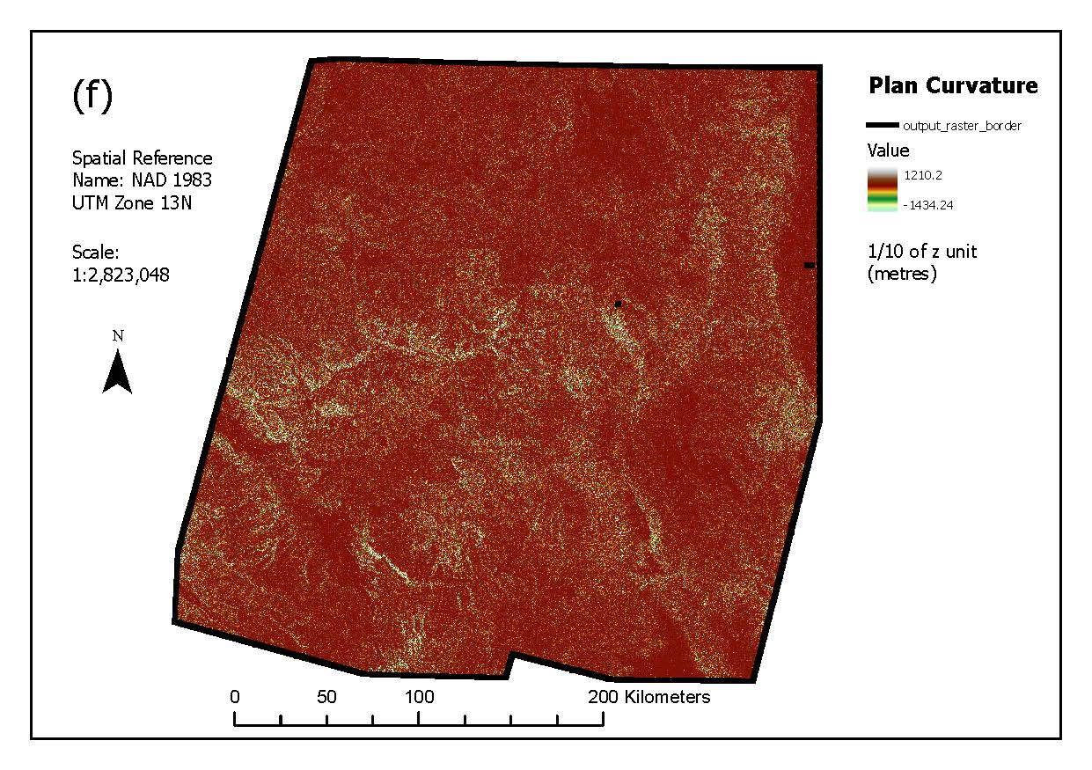
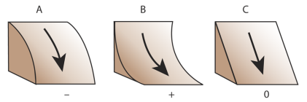
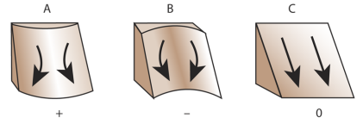
Profile and Plan Curvature

Slide 9
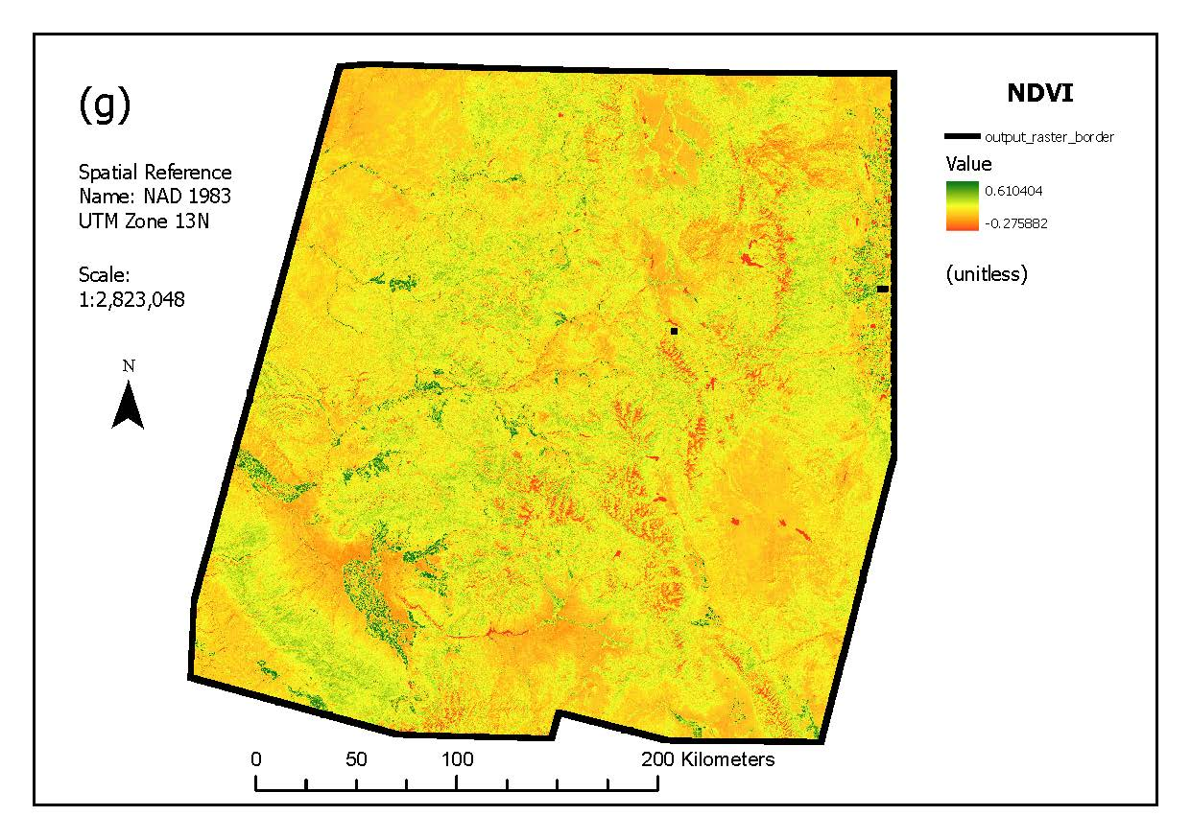
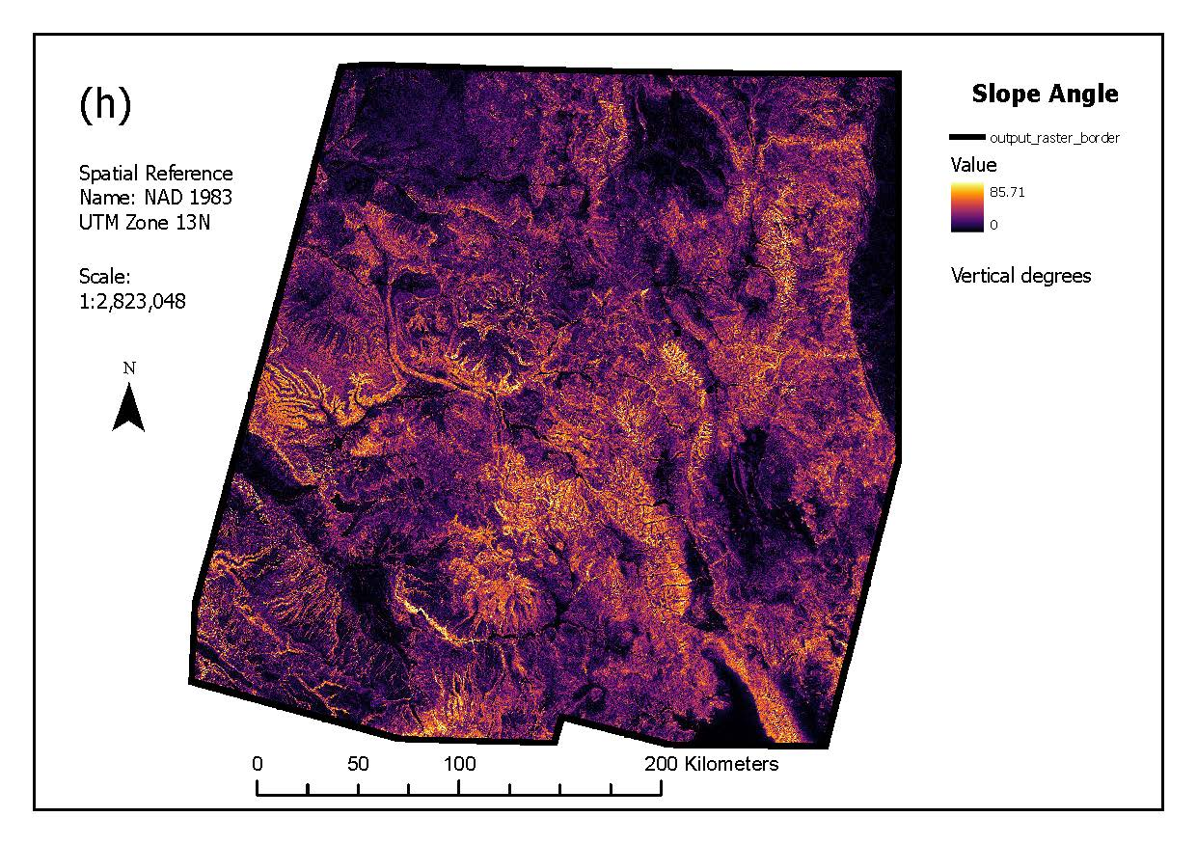

NDVI and Slope Angle
$$\frac{NIR−Red}{NIR+Red}$$

Slide 10
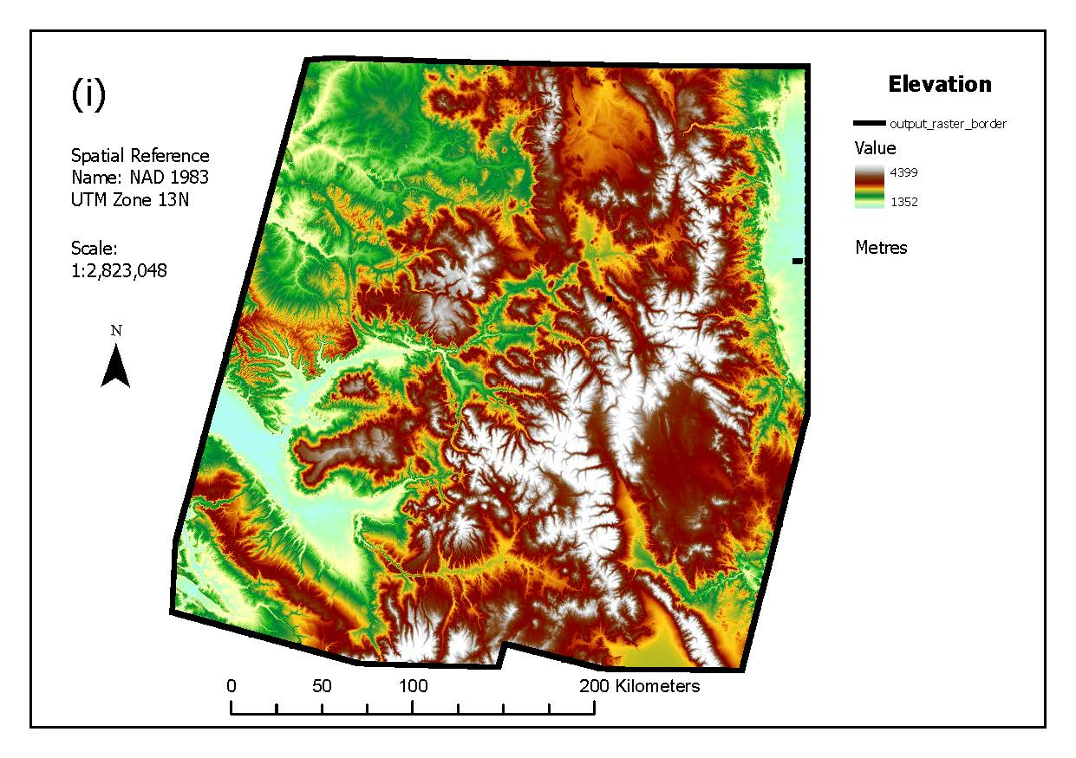
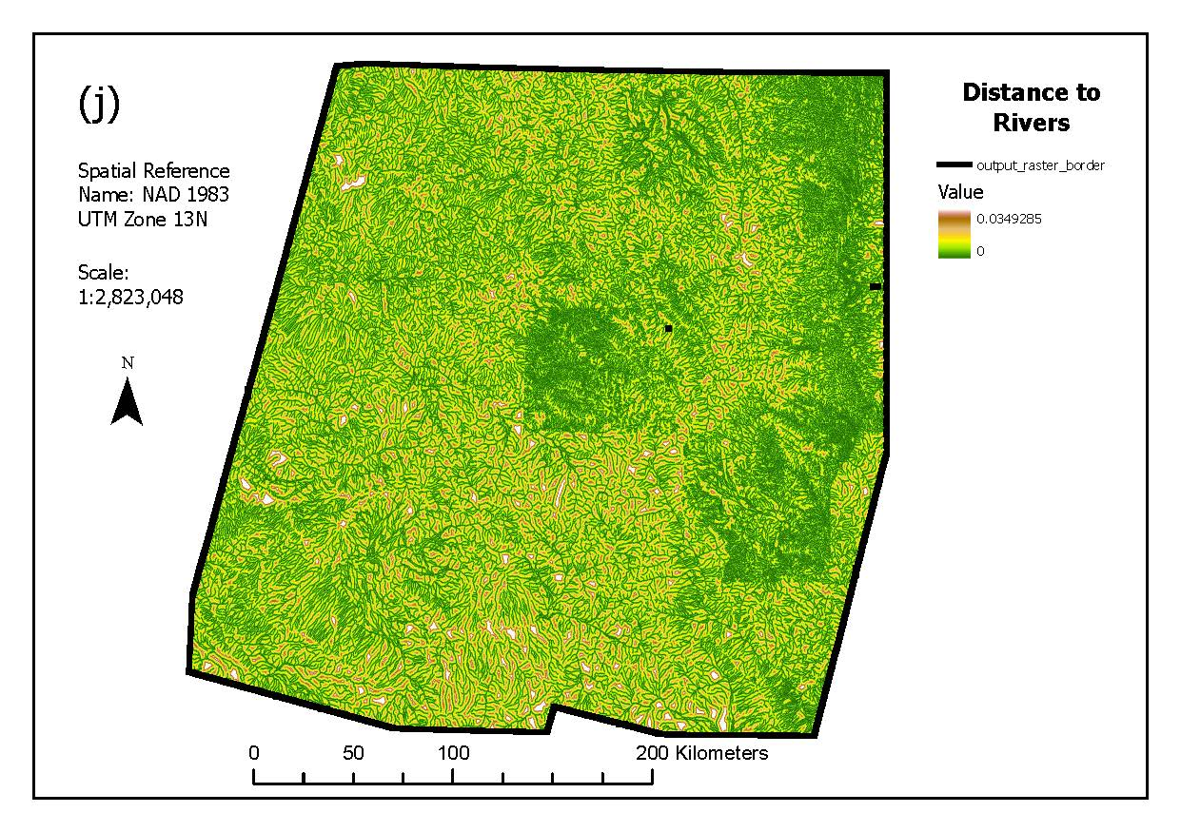
Elevation and Distance to Rivers

Slide 11
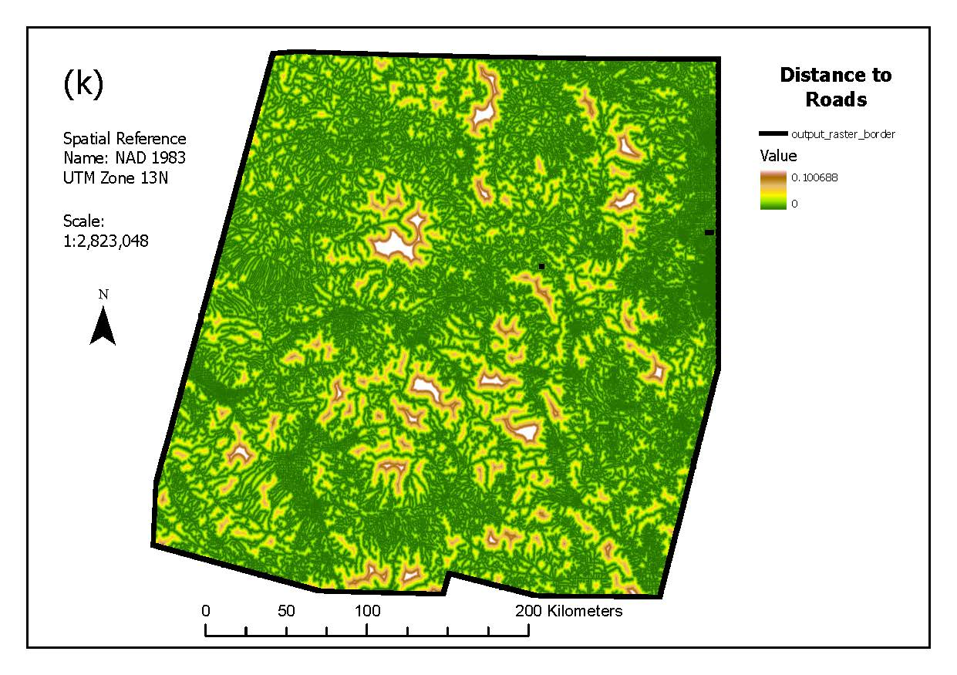
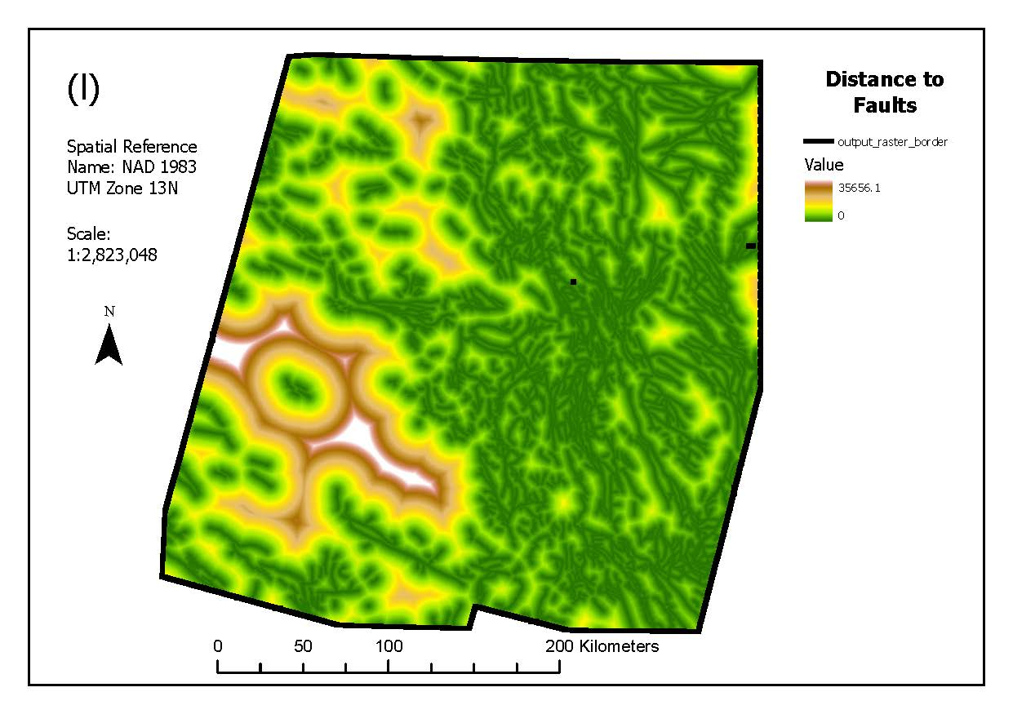
Distance to Roads and Faults

Slide 12
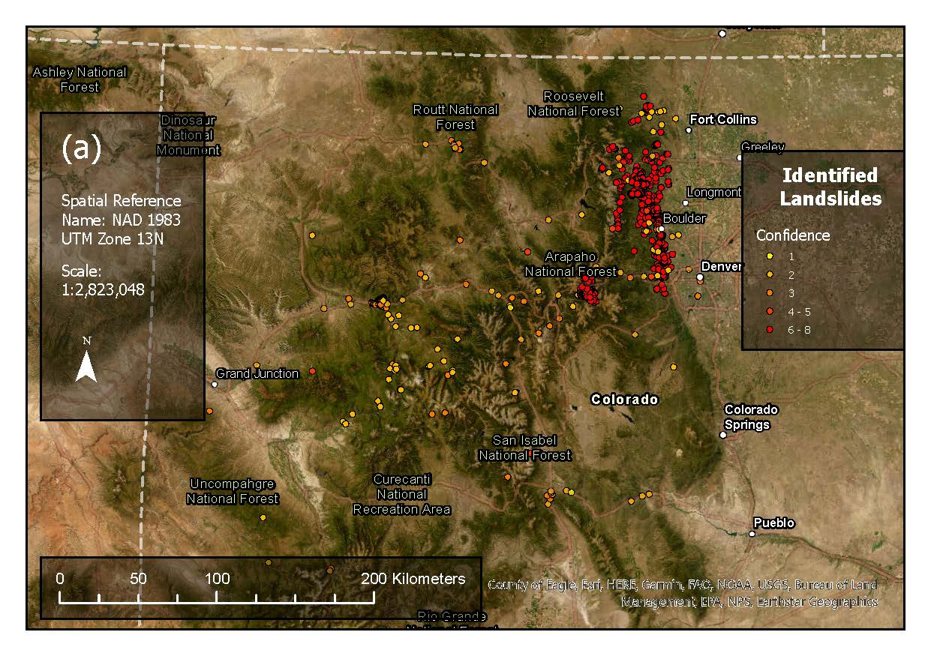
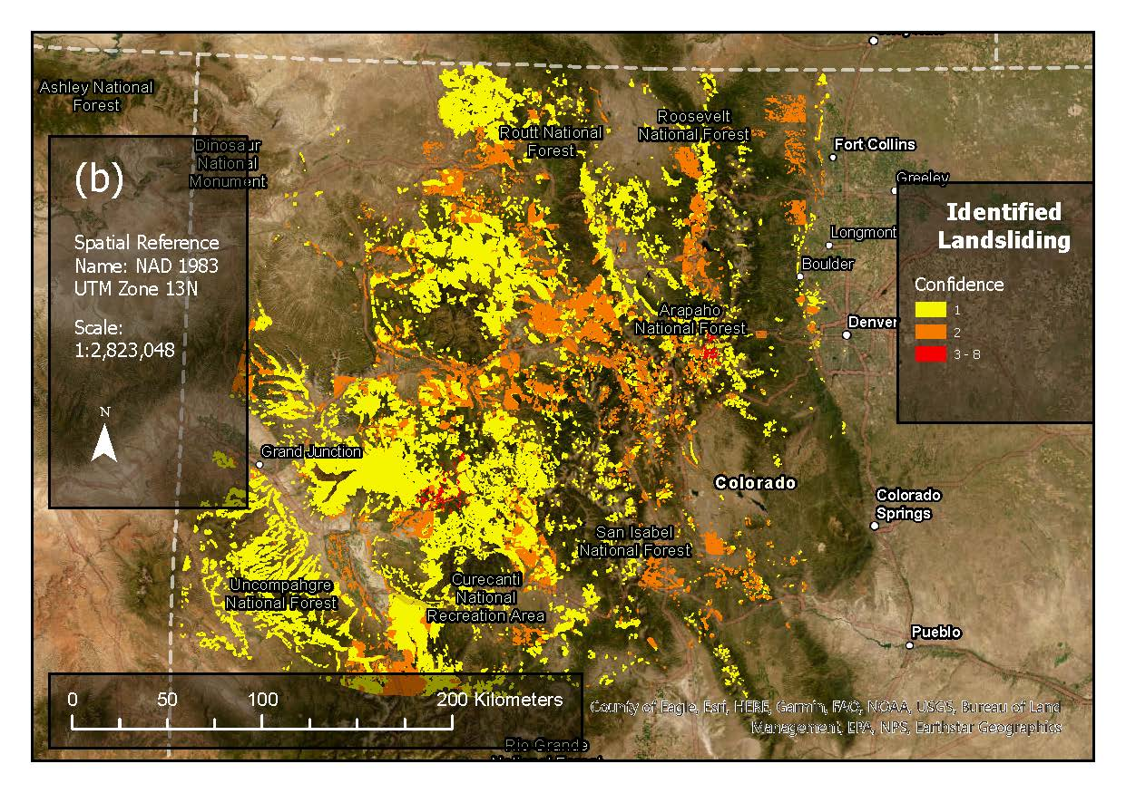
Landslide Inventory
Landslide points
Landslide polygons

Slide 13
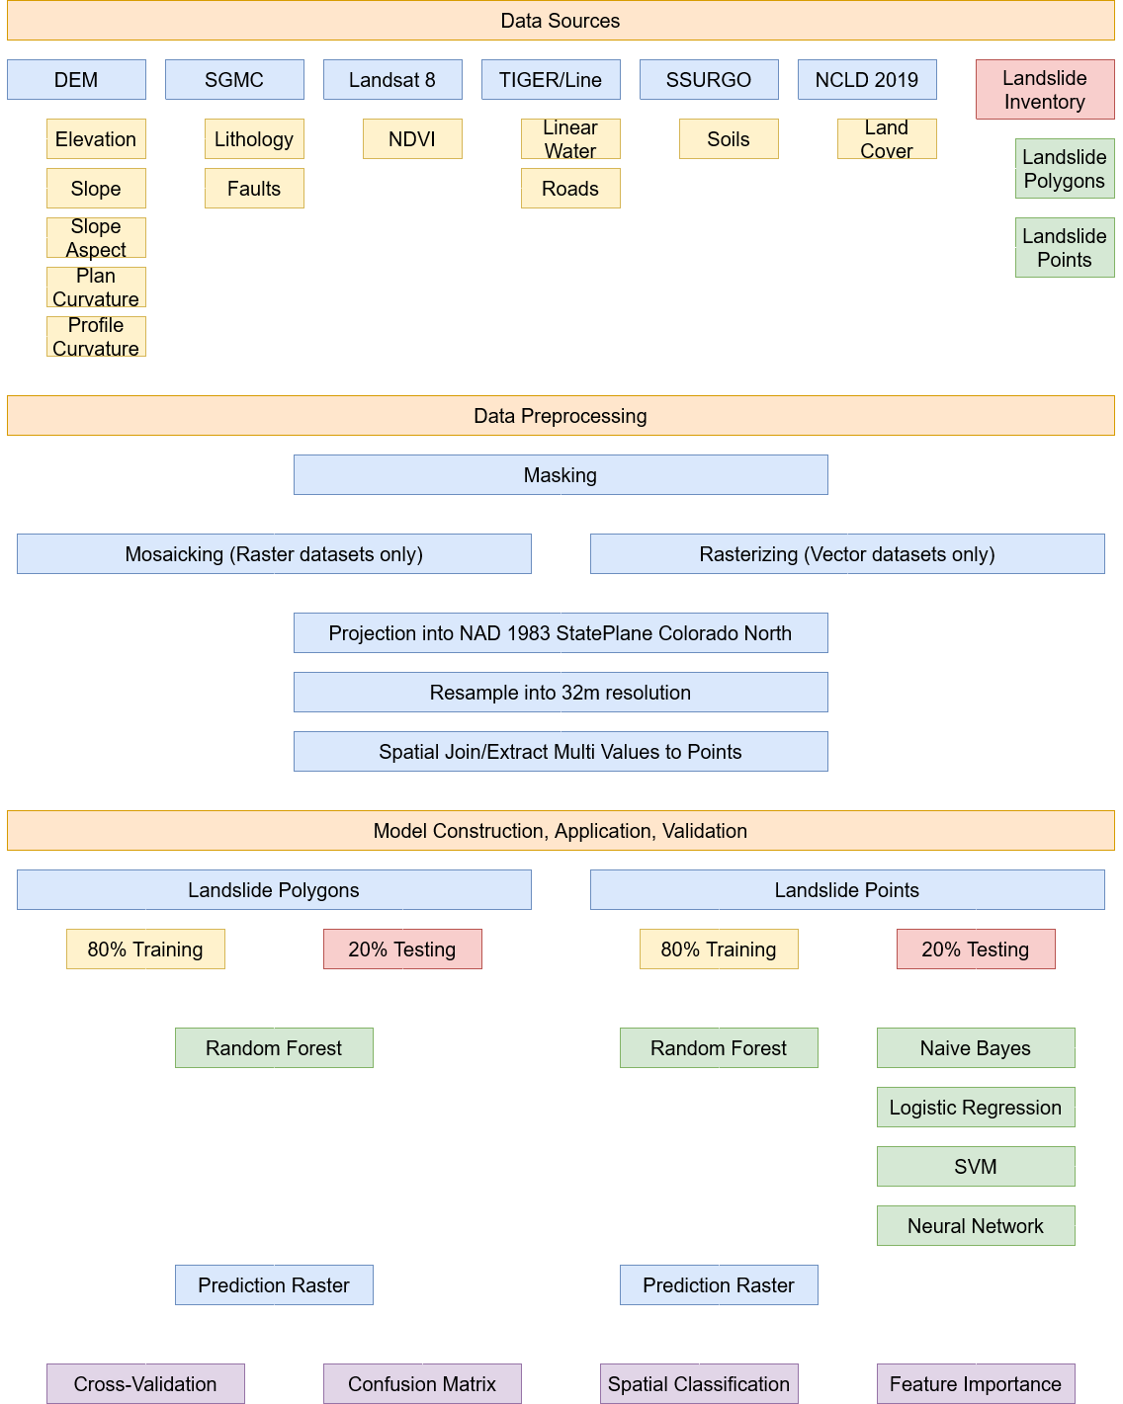
Data Preprocessing

Slide 14
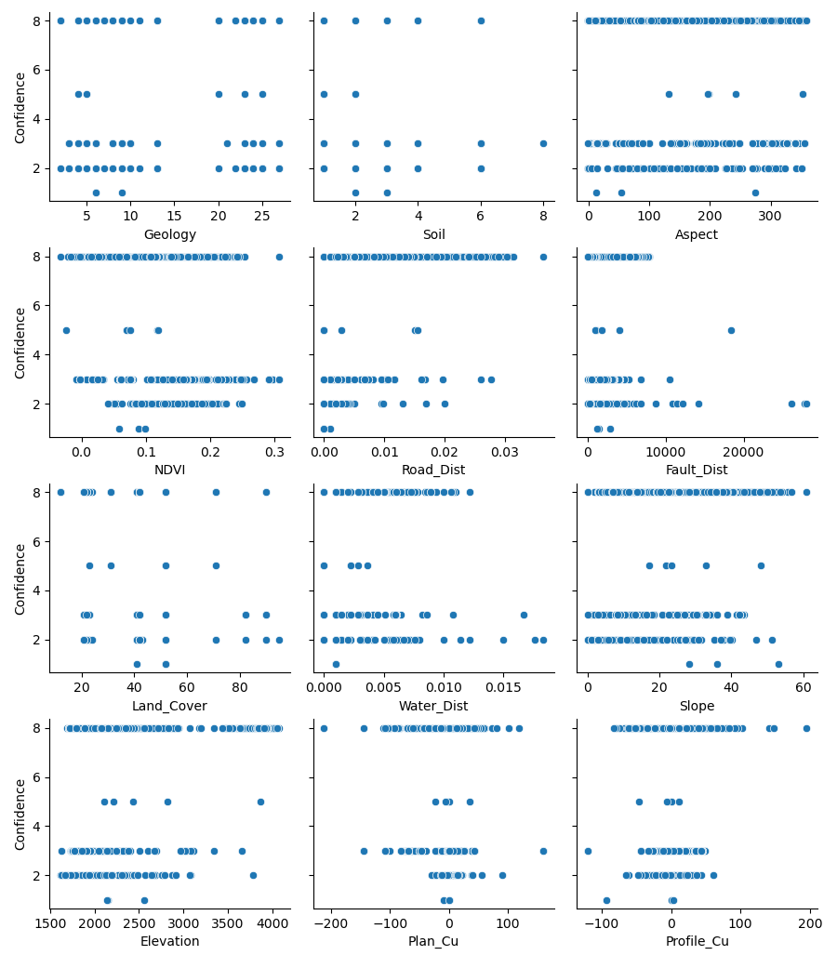
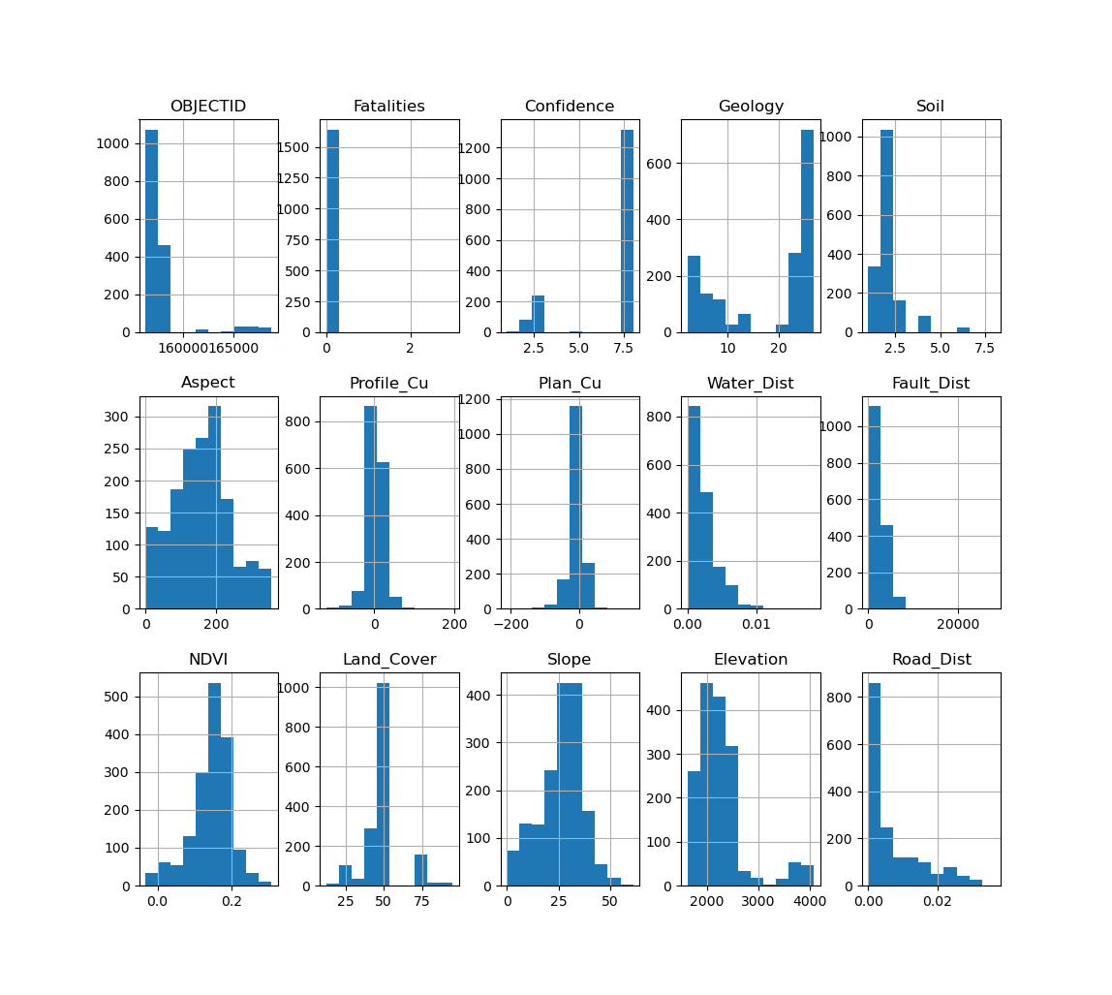
EDA

Slide 15
Model Construction and Application

Slide 16
Model Construction and Application
Landslide points
Landslide polygons
Non-spatial component
Joining and extracting values of each factor at each point
Test classification models
Spatial component
Using random forest to create a prediction raster
Spatial component
Using random forest to create a prediction raster

Slide 17
Nonspatial Point Classification Parameters
Random forest
Estimators: 500, maximum depth: 10, minimum samples per leaf:
Gaussian Naïve Bayes
All default parameters
Support vector machine
Kernel: Radial basis function.
Logistic Regression
Penalty: l2, solver: lbfgs.
Multi-layer perceptron
Activation: ReLU, solver: lbfgs, learning rate: constant.

Slide 18
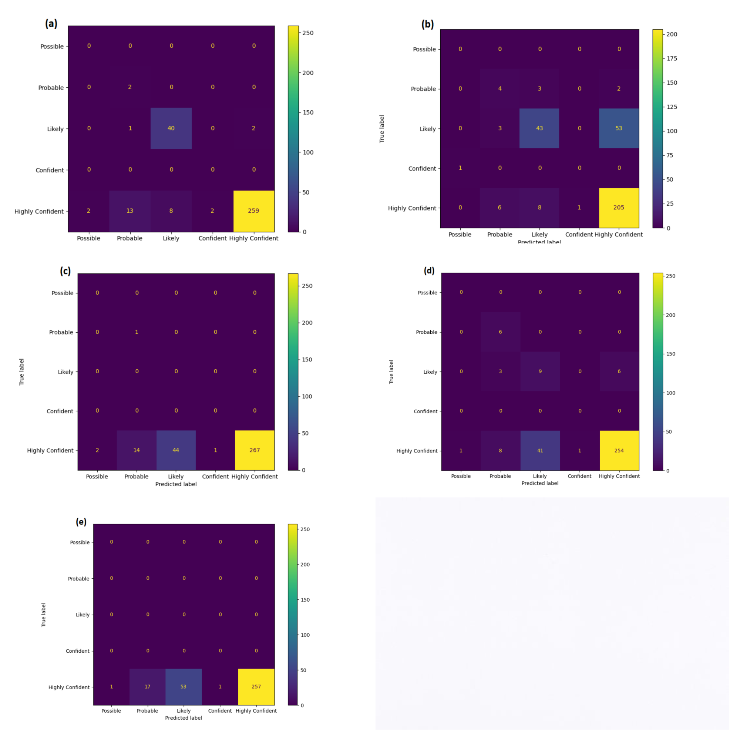
Nonspatial Classification Results
Random forest
5-fold cross-validation accuracy: 0.845
Cross-validation standard deviation: 0.047
Gaussian Naïve Bayes
5-fold cross-validation accuracy: 0.682
Cross-validation standard deviation: 0.18
Support vector machine
5-fold cross-validation accuracy: 0.801
Cross-validation standard deviation: 0.002
Logistic Regression
5-fold cross-validation accuracy: 0.801
Cross-validation standard deviation: 0.057
Multi-layer perceptron
5-fold cross-validation accuracy: 0.802
Cross-validation standard deviation: 0.001

Slide 19
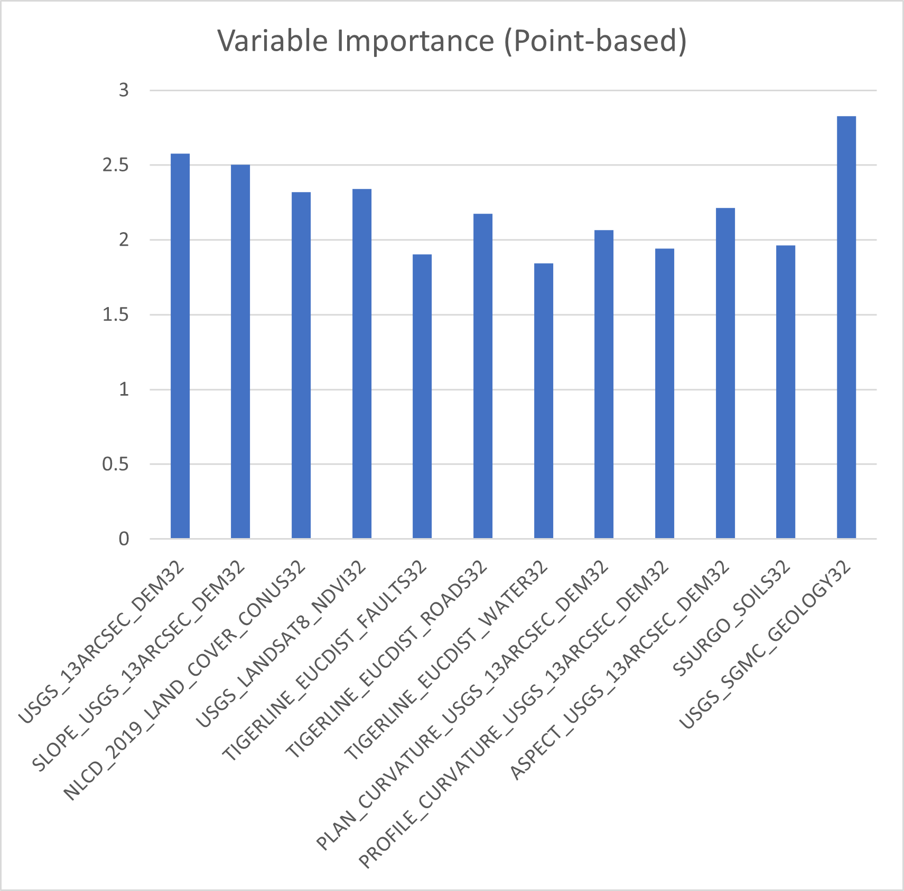
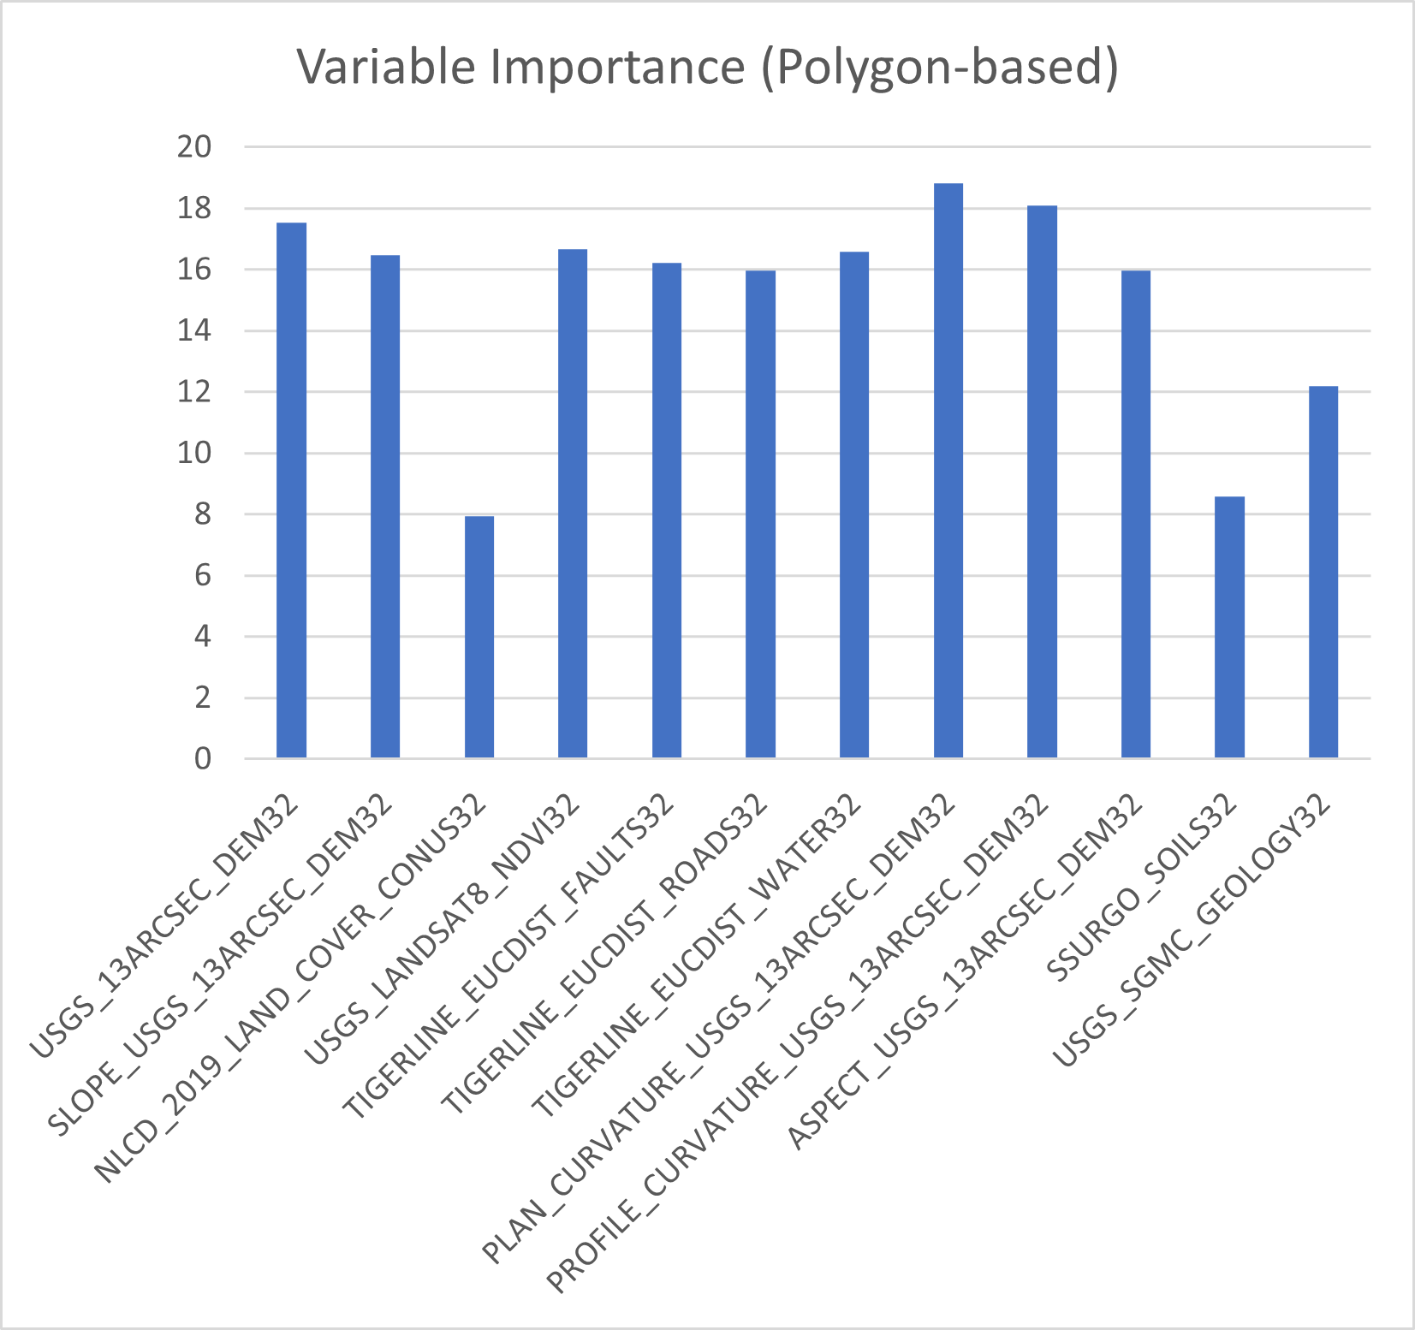
Variable Importance
Point-based
Polygon-based

Slide 20
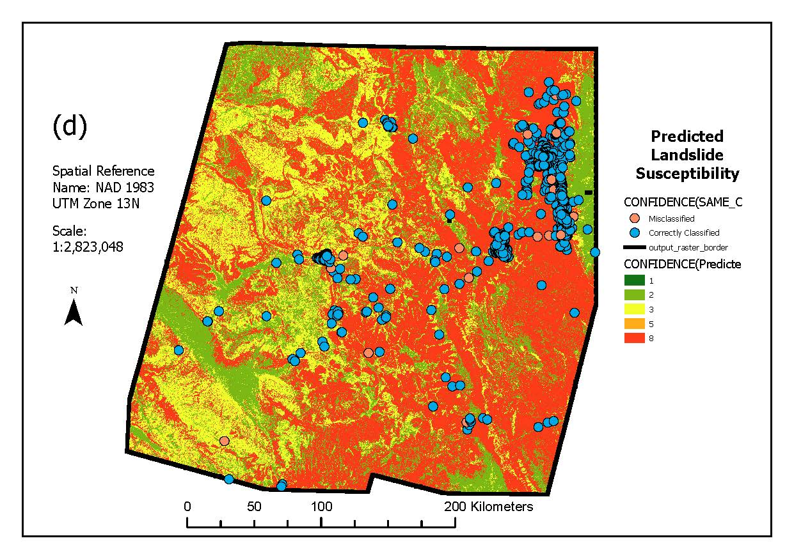
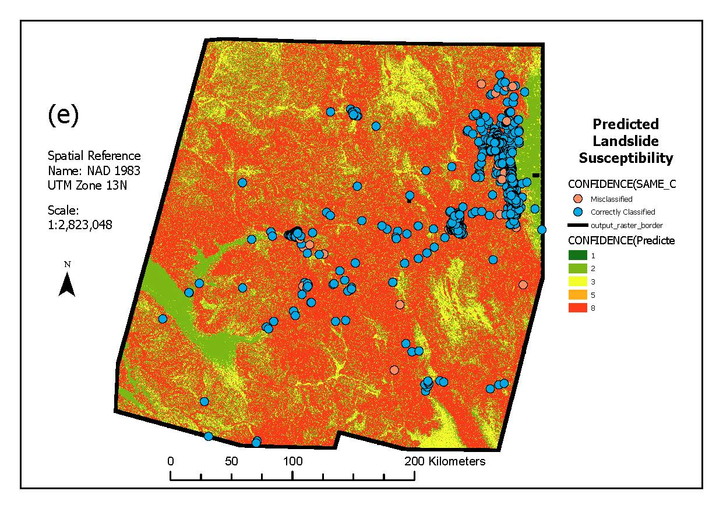
Point-based Spatial Classification
All features
Important features

Slide 21
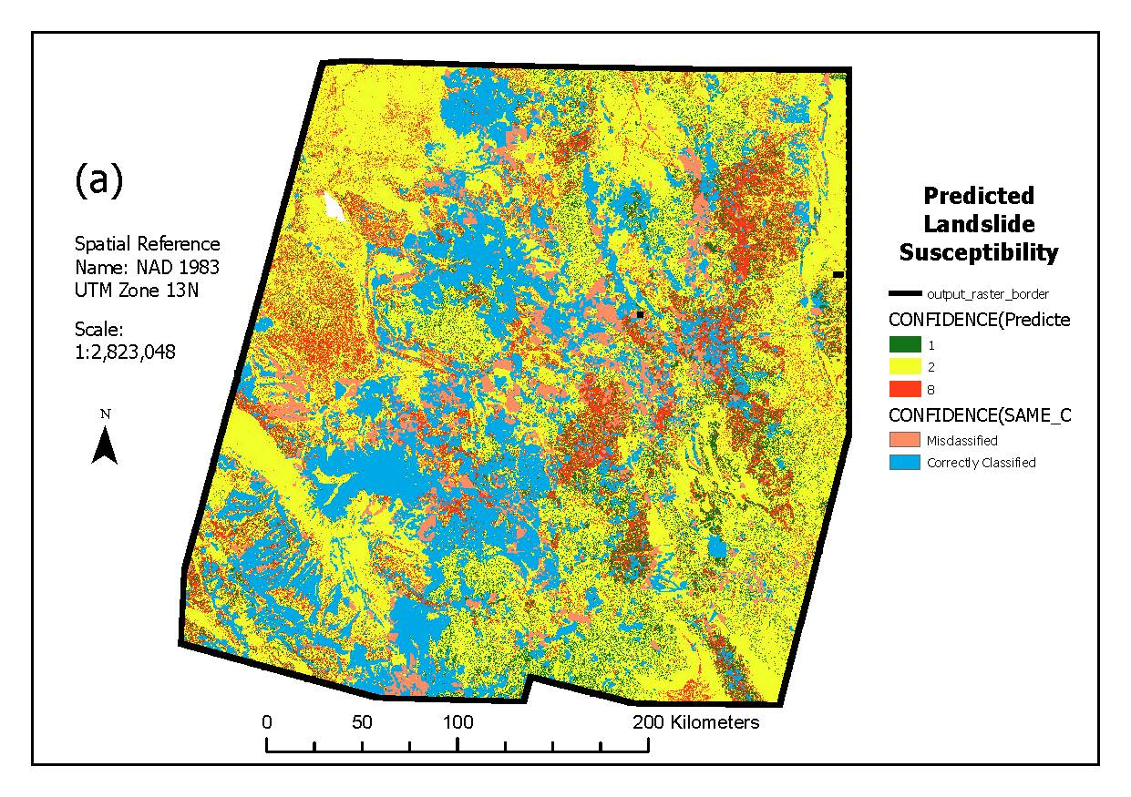
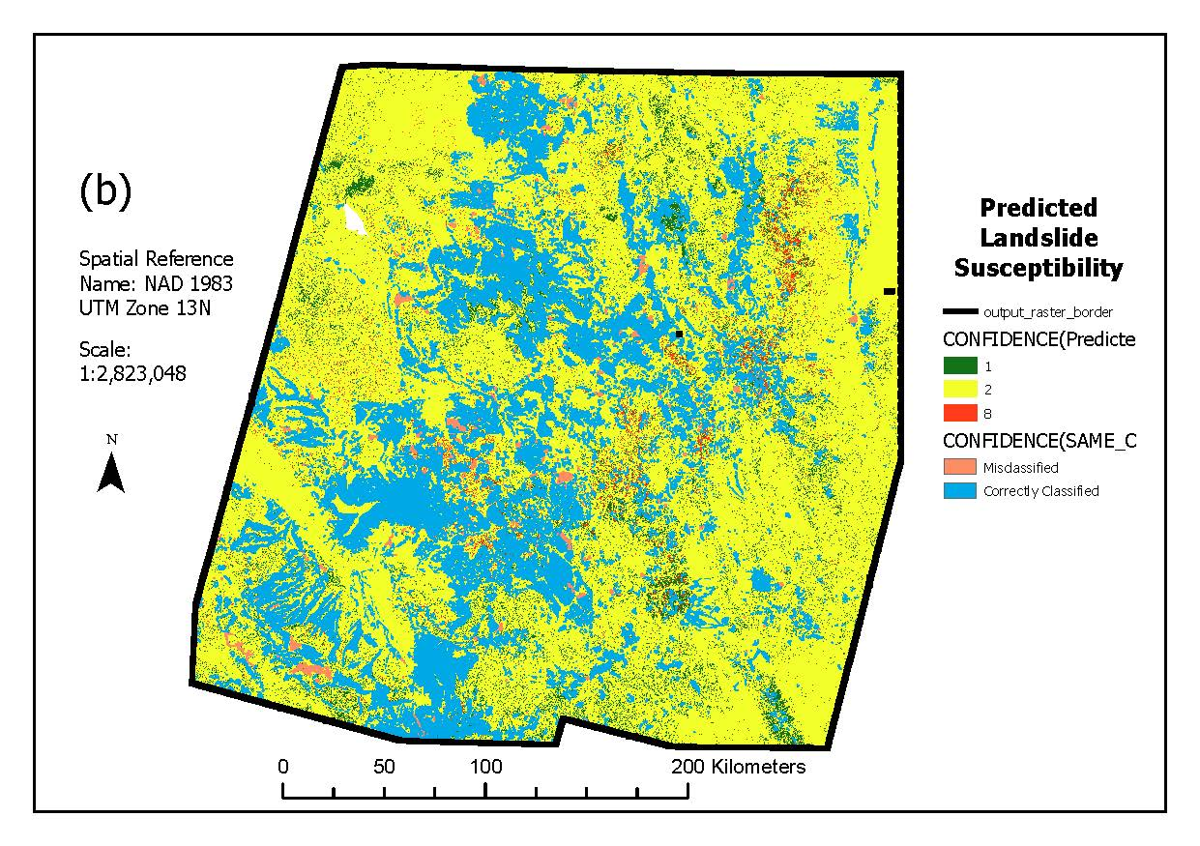
Polygon-based Spatial Classification
Correcting for sparsity
No sparse correction

Slide 22
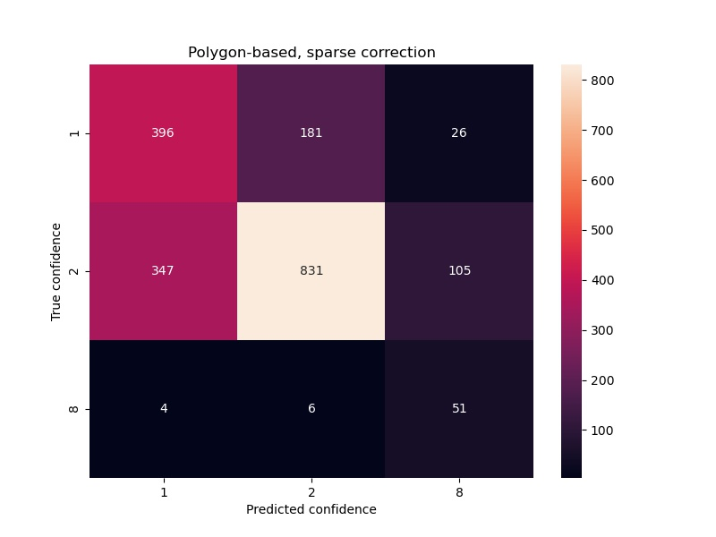
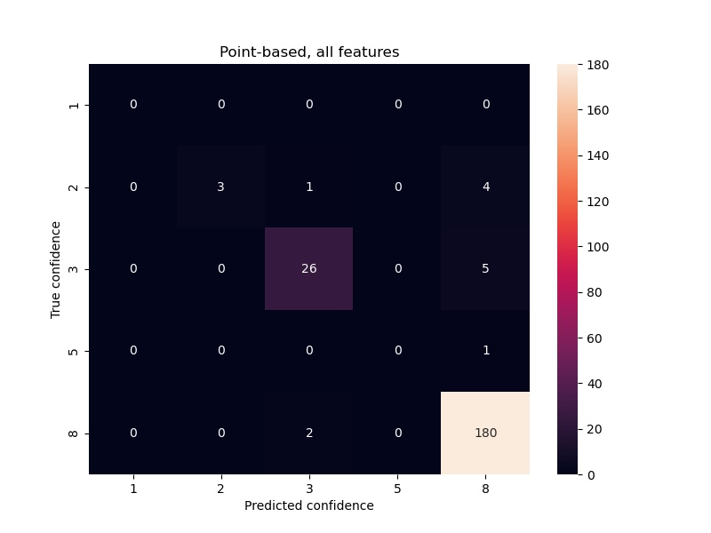
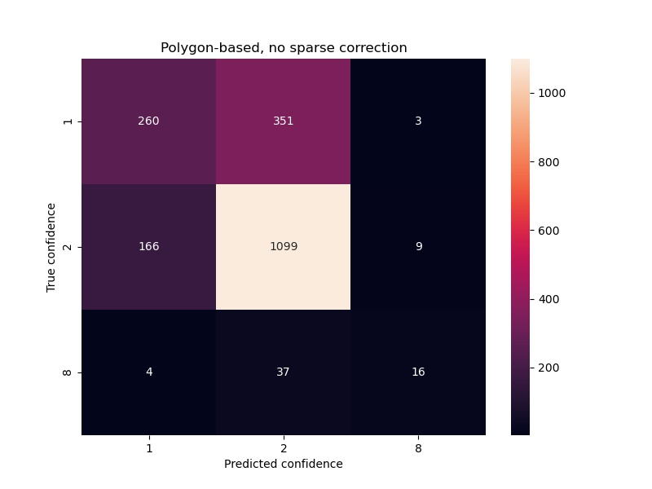
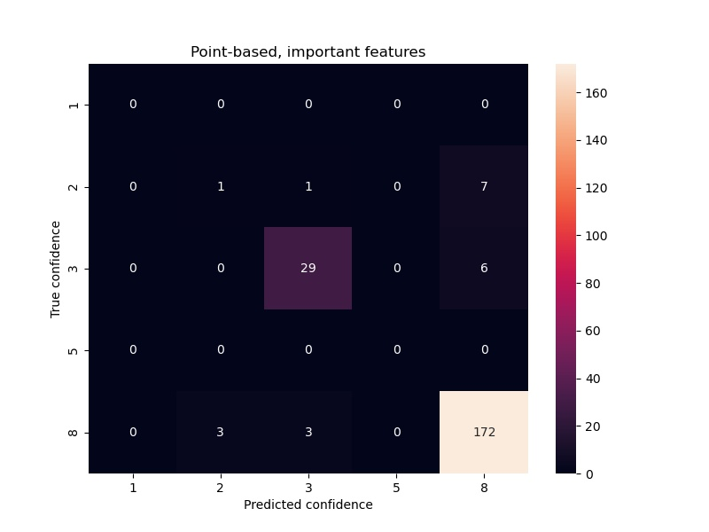
Spatial Classification Confusion Matrices

Slide 23
Discussion
Model evaluation
Random forest retained the consistently highest cross-validation accuracy and low standard deviation
Accuracy of around 84% is very good, but has room for improvement
Inventory limitations
Heavily biased and imbalanced landslide points dataset
Landslide polygons having few high confidence values
Open questions/future work
Optimal parameters for each model
Incorporation of physical laws and dynamics
Support vector machine, logistic regression, and multi-layer perceptron are not far behind
Notably diverse results from spatial classification

Slide 24
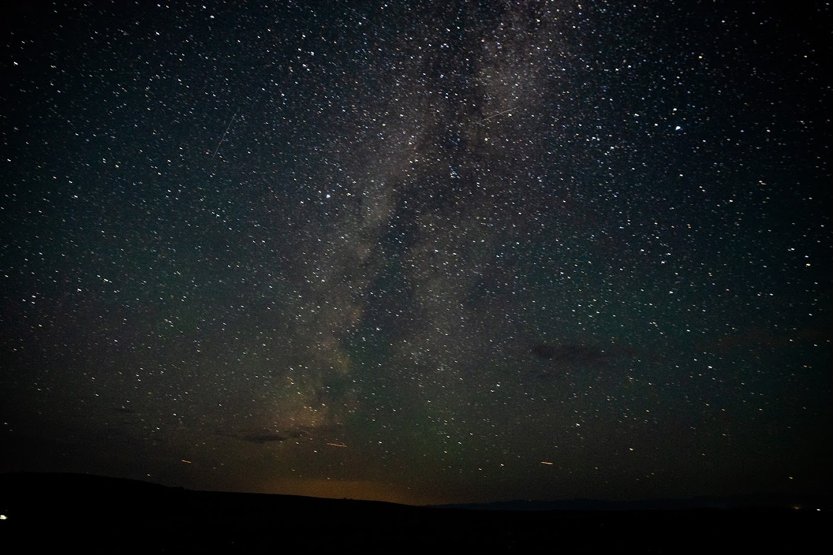
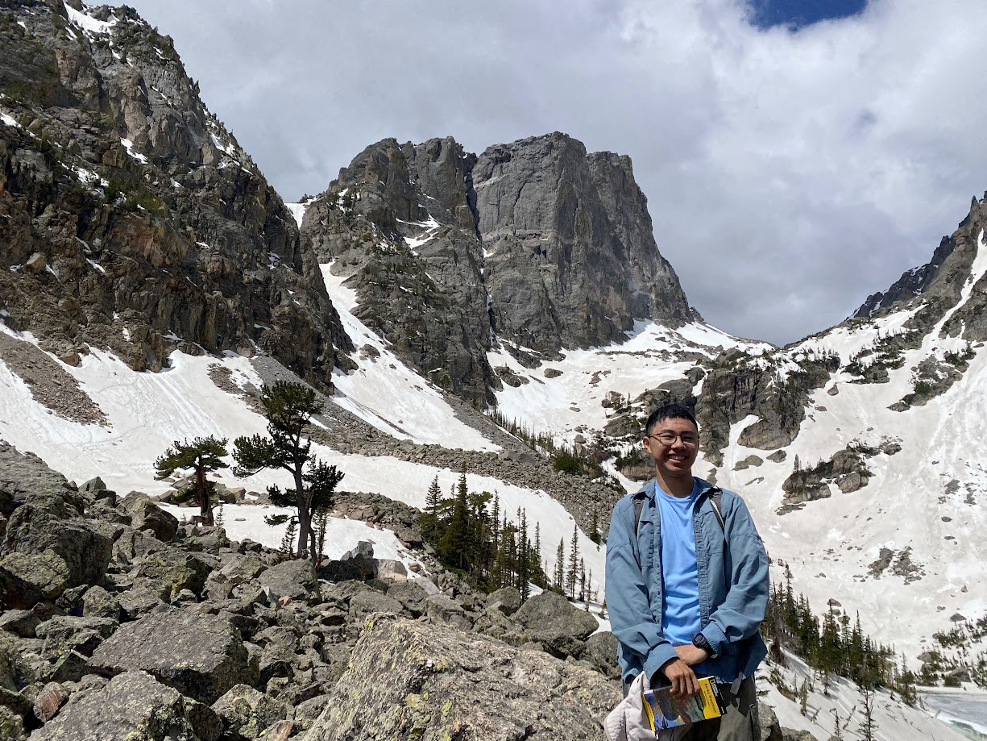
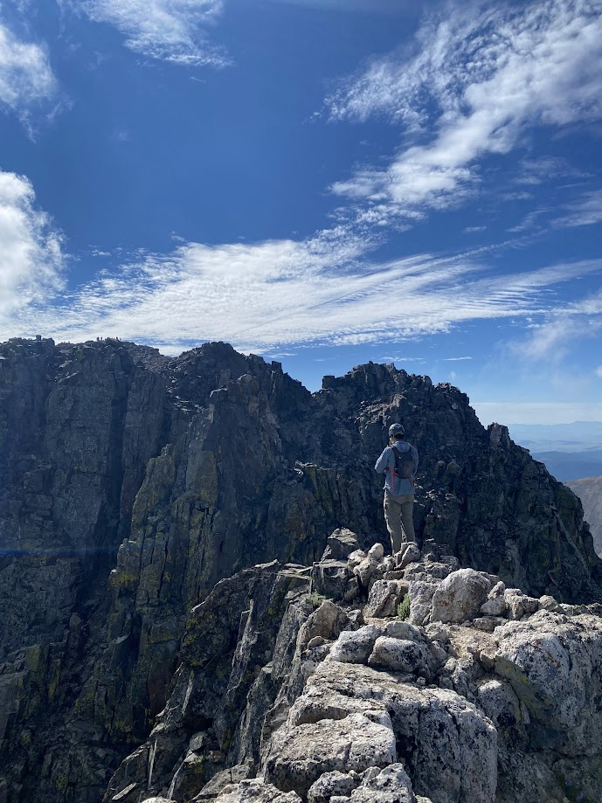
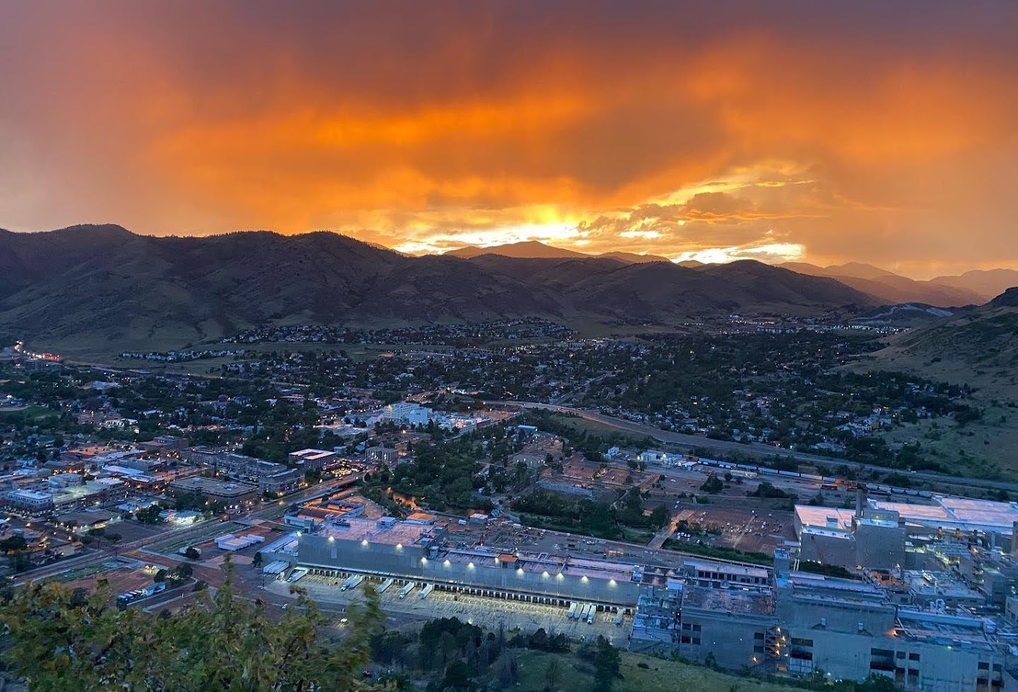
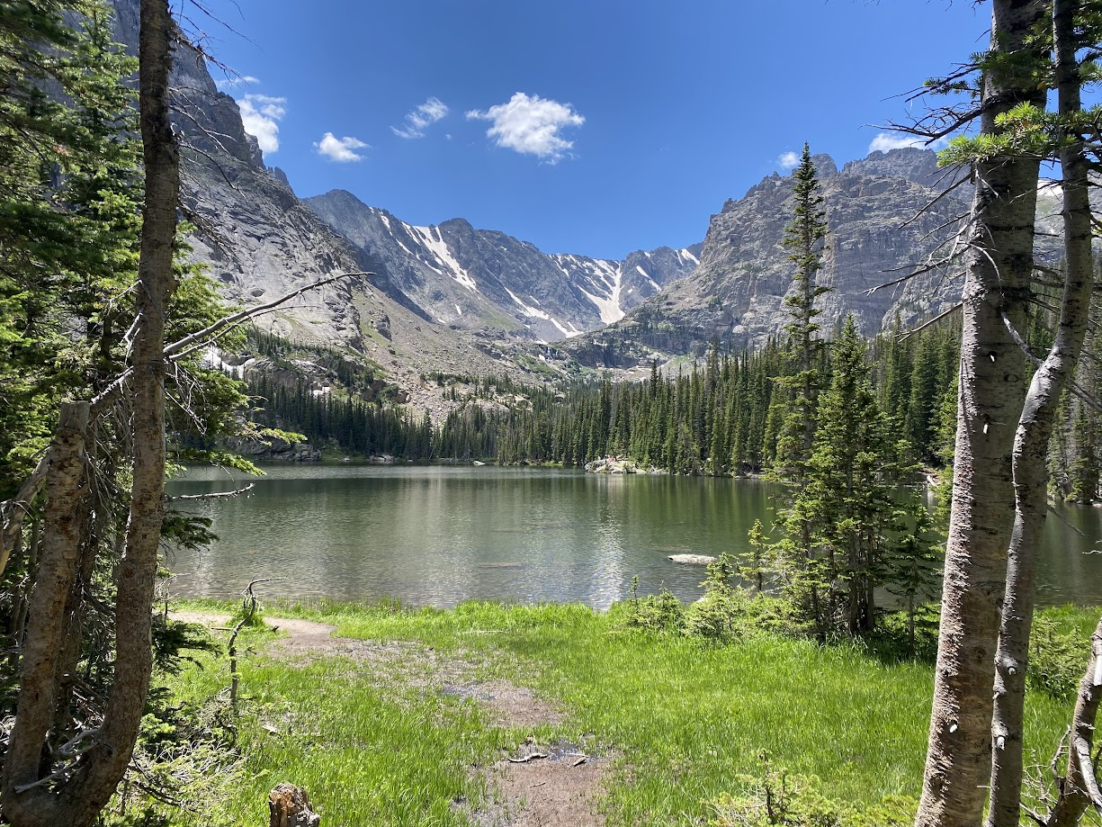
Questions?

